Slide 1
Grouting
2019
Basic Drilling Fluids HDD Applications
Cebo Holland B.V.

Slide 2
Grouting
Why Grout?
  To minimize the chance of ground settling after installation of the pipe(s)
  To prevent seepage of surface water into a groundwater layer
  To protect steel pipes against corrosion
  To gain a specific thermal conductivity and/or resistivity

Slide 3


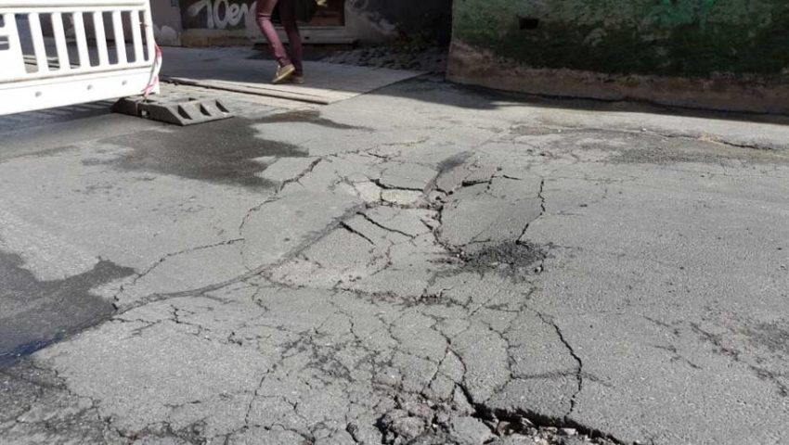
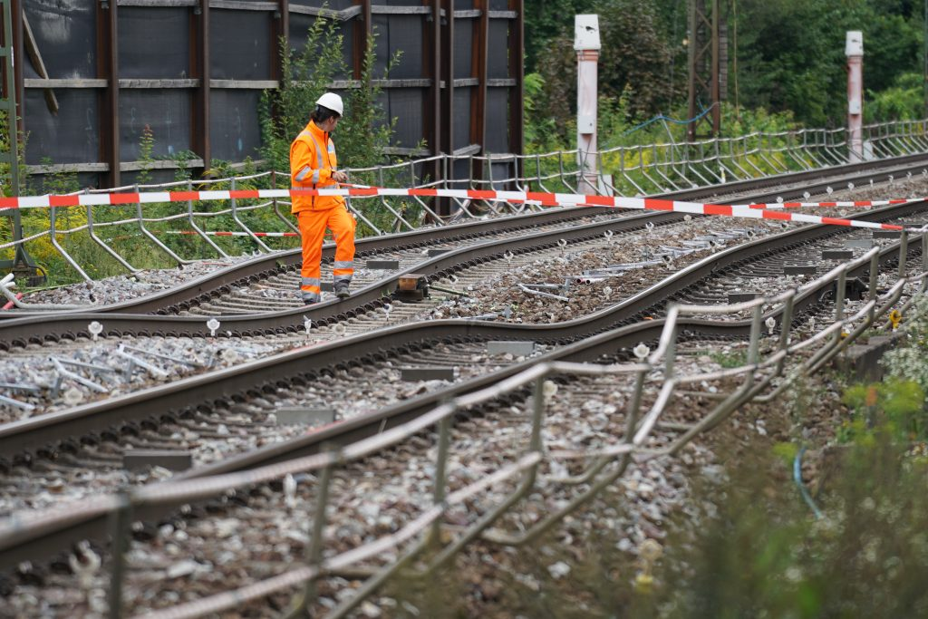
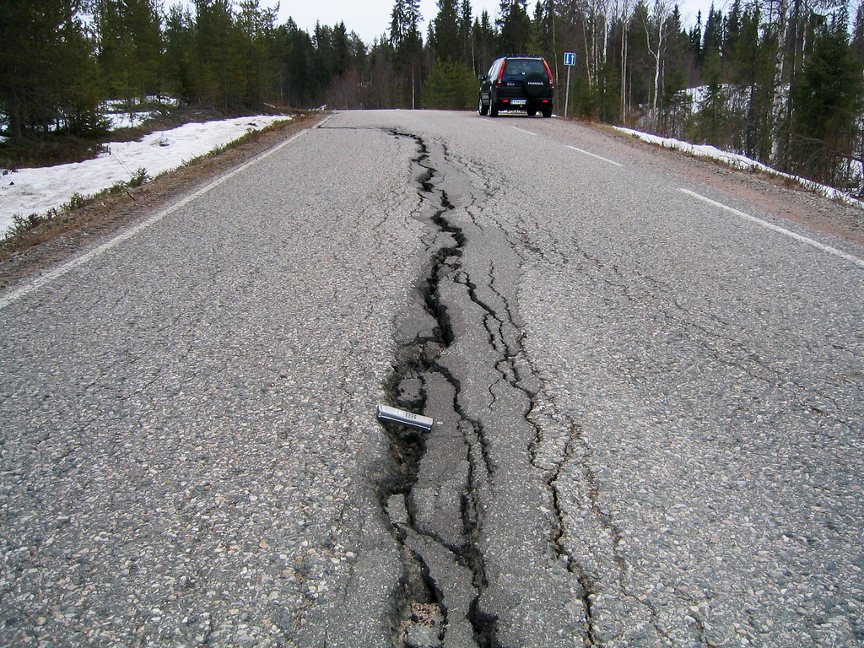
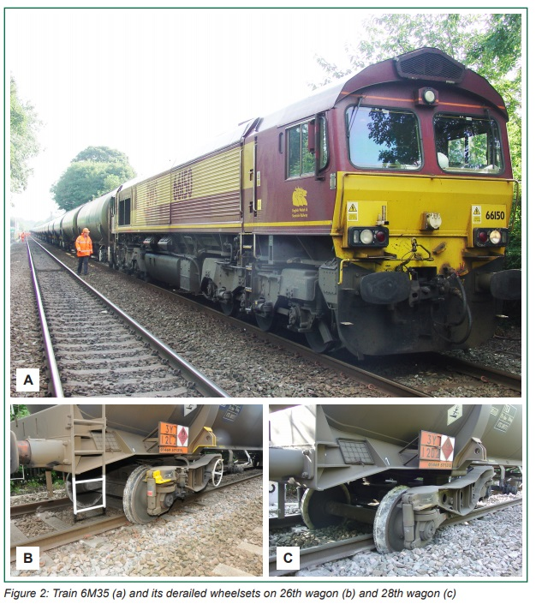
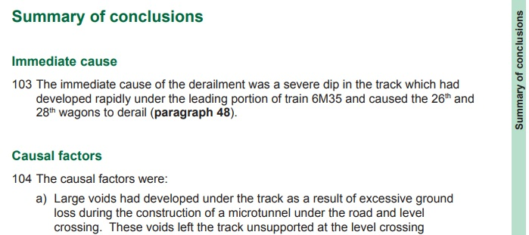
Grouting
Settlement of ground after installation of the product pipe(s)

Slide 4
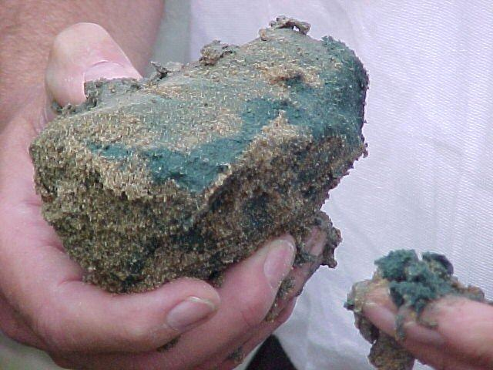
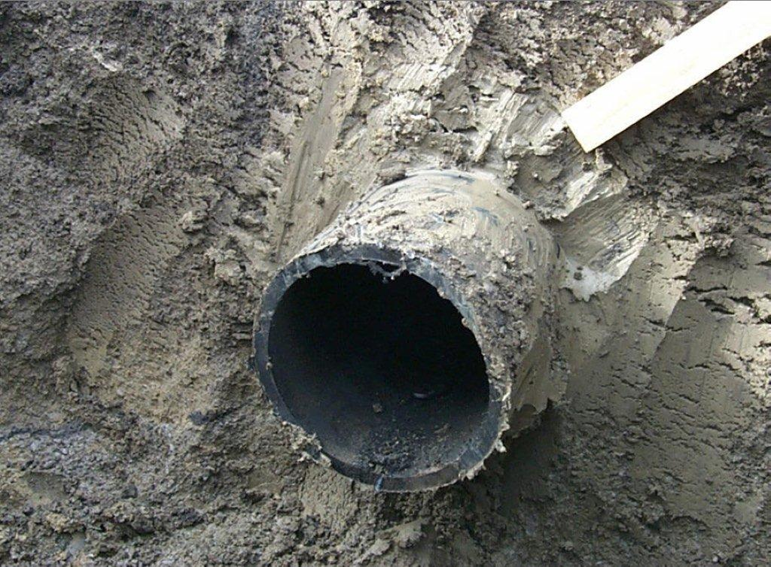
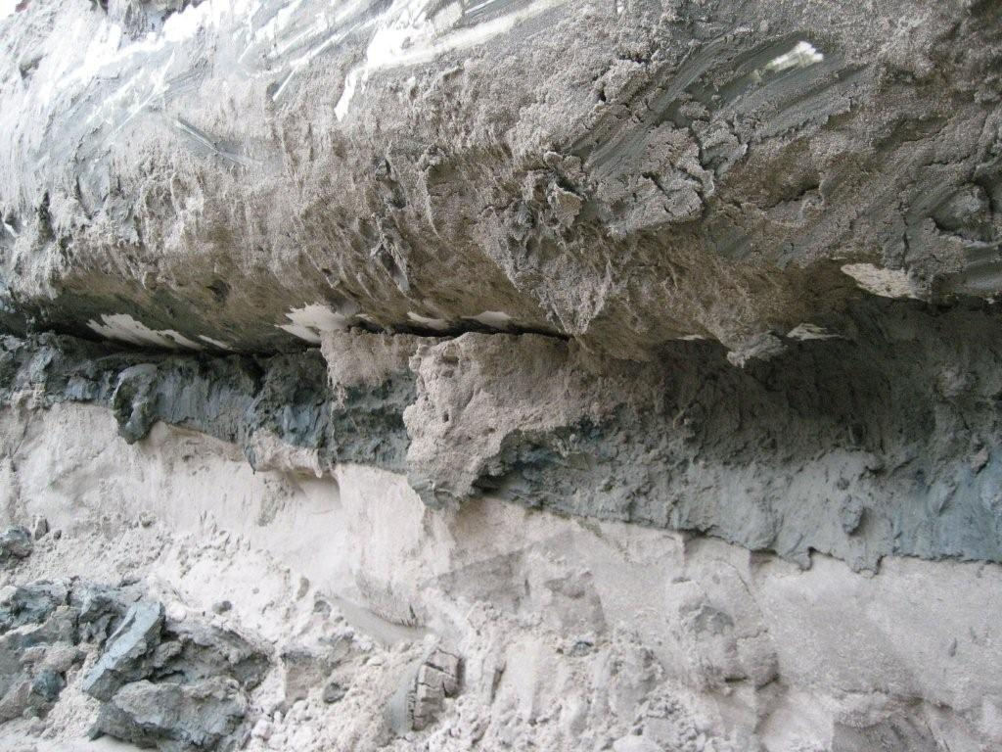
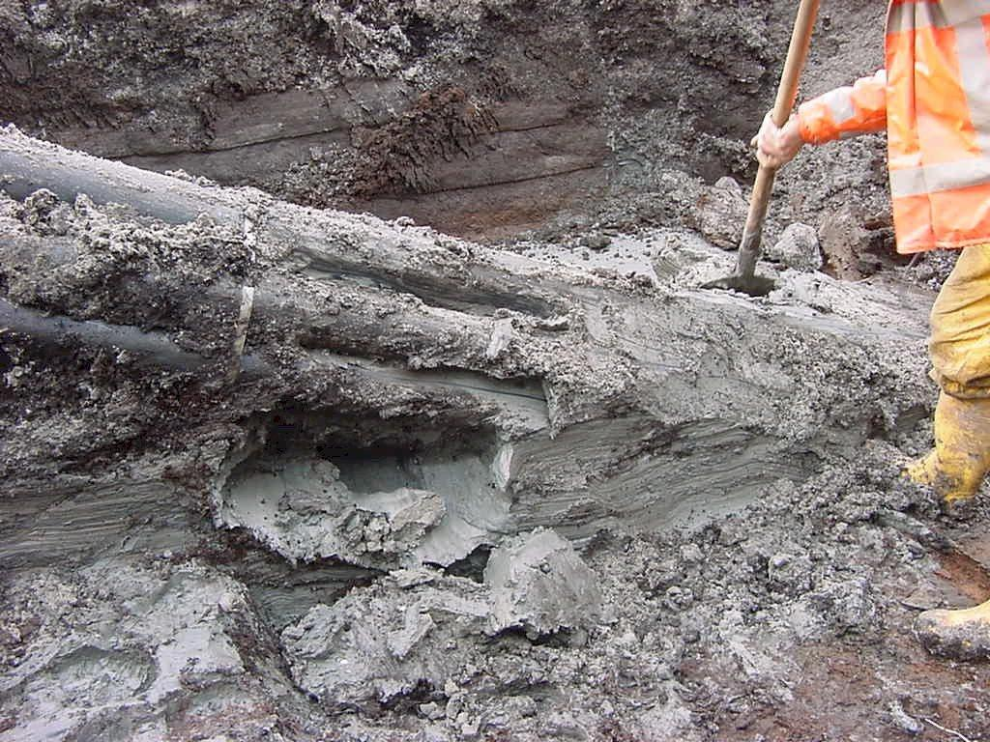
Grouting
CEBO DRILL-GROUT
CEBO DRILL-GROUT PLUS

Slide 5
Grouting
Installation of grout using an injection pipe
Injection pipe
Injection pipe
Grout
Product pipe
Ground
Ground
Old drilling fluid

Slide 6
Grouting
Ground
Annular space completely filled
20%
80%
Barrel Reamer
Product Pipe
Swivel
Ground

Slide 7
Grouting
Thermal conductive grout
  To improve the transmission of heat from power cables to the ground
    More efficiency from power cables
    Applied between the power cable and the PE pipe
  Commonly used in vertical geothermal applications
    To improve the transmission of ground heat to the system

Slide 8
Grouting
Annular gab between jacket tube
and cable backfilled with;
  Air
  Water
  Bentonite slurry
  Building material

Slide 9
Grouting
Cebo Conduct-Gel
  Easy mixable
  Low mixing ratio
  High flowability
  Low weight suspension
  Higher heat transfer than basic fluids
  Non-hardening suspension
  Removable after time

Slide 10
Grouting
Product | (average) mixing ratio per m³ | Thermal conductivity | Thermal resistivity
Water | N/A | 0,58 W/m*K | 1,72 m*K/W
Bentonite fluids | 25 – 70 kg/m³ | 0,6 W/m*K | 1,67 m*K/W
Cement grouts | 160 – 220 kg/m³ | 0,8 W/m*K | 1,25 m*K/W
 | 175 kg/m³ | 1,05 W/m*K | 0,95 m*K/W
 | 844 kg/m³ | 1,25 W/m*K | 0,8 m*K/W
 | 844 kg/m³ | 1,43 W/m*K | 0,7 m*K/W
 | 844 kg/m³ | 2,0 W/m*K | 0,5 m*K/W
Cebo conduct-gel 1,0
Cebo conduct-gel 1,3
Cebo conduct-gel 1,5
Cebo conduct-gel 2,0

Slide 11
Grouting
Heat emission from power line to annular gab and jacket tube
Depending on backfilling material,
heat transfer could be hindered
Aim;
  Optimal heat dissipation to prevent
  temperature peaks;
    Unexpected load limitations
    Material fatiques of the cables
    Total cable breakdown
Temperature gradient
High voltage power line
Soil
Jacket tube

Slide 12
Grouting
Jacket tube, no backfilling
Jacket tube, backfilled with
2,0 W/m*K material

Slide 13
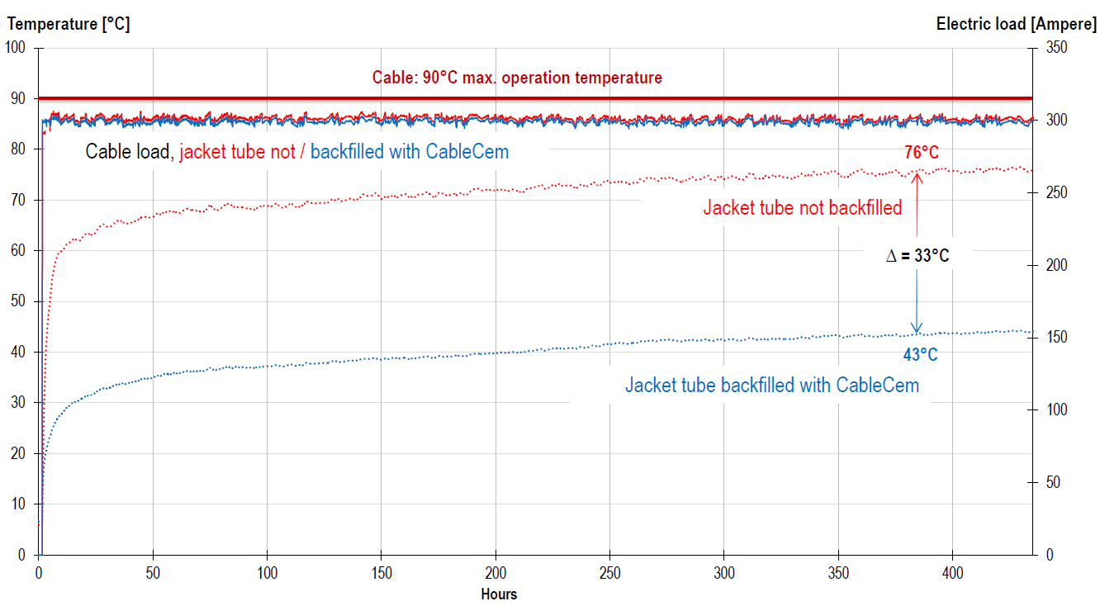
Grouting
Profile1: constant load = 300 A
Cable: 90◦C max. operation temperature
Cable load, Jacket tube not / backfilled with 2,0 W/m*K
Jacket tube not backfilled
Jacket tube backfilled with 2,0 W/m*K

Slide 14
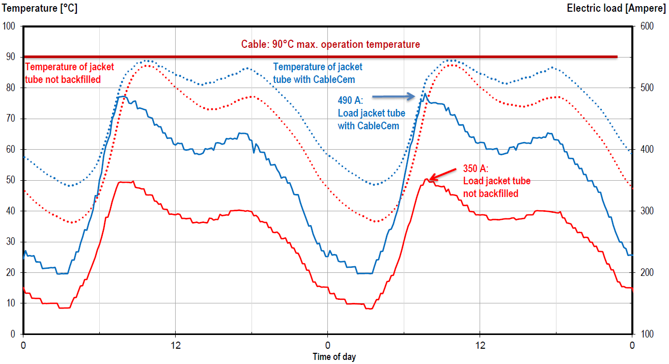
Grouting
Profile 2: Standard load profile, degree of burden = 0,7
Cable: 90◦C max. operation temperature
Temperature of jacket tube not backfilled
Temperature of jacket tube with 2,0 W/m*K
Load jacket tube
with 2,0 W/m*K
350 A:
Load jacket tube not backfilled

Slide 15

Grouting
Profile 3: Load profile with feed-in of photovoltaics, Degree of burden = 0,4
Cable: 90◦C max. operation temperature
Temp. of jacket tube not backfilled
Temp. of
jacket tube with 2,0 W/m*K
515 A:
Jacket tube
with 2,0 W/m*K
350 A:
Jacket tube not
backfilled

Slide 16
Grouting
Thermal resistivity / thermal conductivity of the surrounding soil* | Increase of the current load capacity by backfilling with 2,0 W/m*K
 | Stationary | Transient
 | Profile 1 | Profile 2 | Profile 3
[(m*K)/W] / [W/m*K] | [%] | [%] | [%]
2,5 / 0,4 | 10,1 | 11,5 | 17,2
1,5 / 0,67 | 13,2 | 21,4 | 25,8
1,0 / 1,0 | 16,4 | 22,6 | 27,3
0,7 / 1,4 | 18,3 | 27,3 | 33,3
*Effect of drying out of the soil was excluded

Slide 17
Grouting
Summary of the test runs;
  Cable – jacket tube system, not backfilled
    High thermal resisitivity between power line and jacket tube and surrounding soil
    Poor heat dissipation
    Cable heating
    Limitation of electric load (in test runs max. 350A)
  Cable – jacket tube system, backfilled with 2,0 W/m*K
    Significantly higher heat dissipation
    Lower cable temperature
    Higher electric load (in test runs >500 A)

Slide 18
Grouting
Requirements;
  Complete backfilling of the annular gab between power line and jacket tube
  High flowability, especially for long cable runs, (HDD > 1.000 m)
  Long-term stability, otherwise voids with high thermal resistivity could arise
  Easy to dismantle
  Highest possible heat conductivity, adapted to the system performances of the entire cable run
Properties;
  Easy flowing, no grains/aggregates
  Easy flowing, sufficient workability
  No segregation, gel-like structure
  Gel-like structure
  Heat conductivity adjustible within a range of 1,0 – 2,0 W/m*K

Slide 19
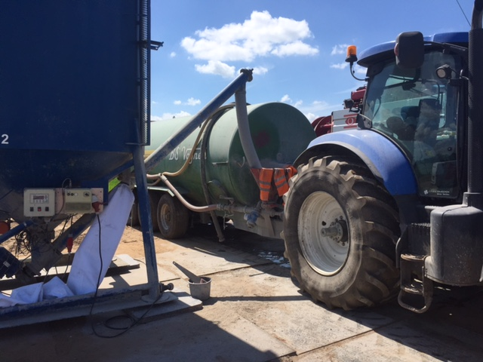
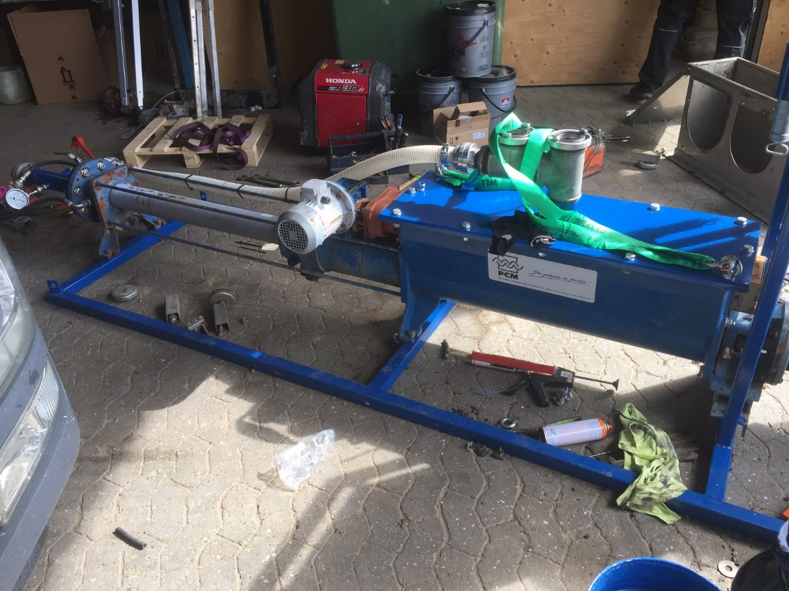
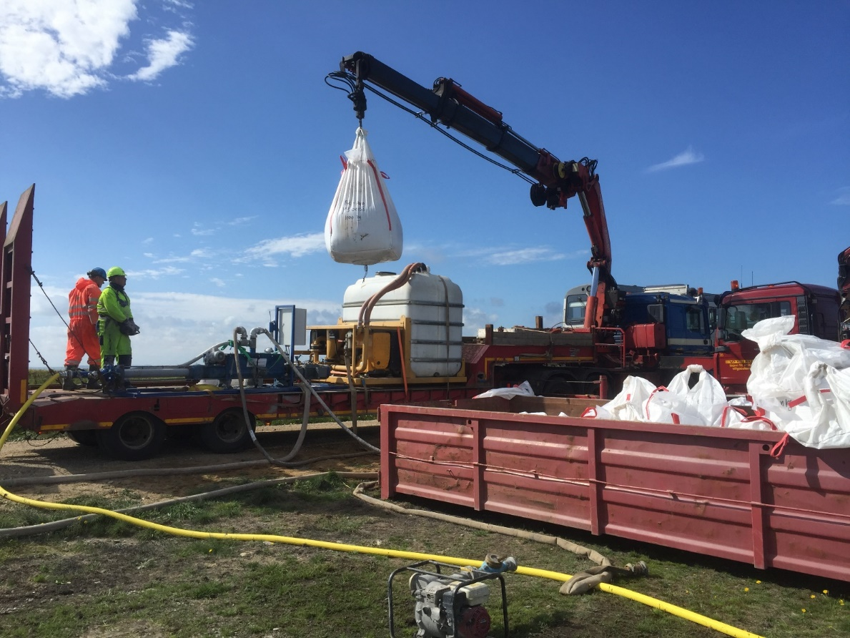
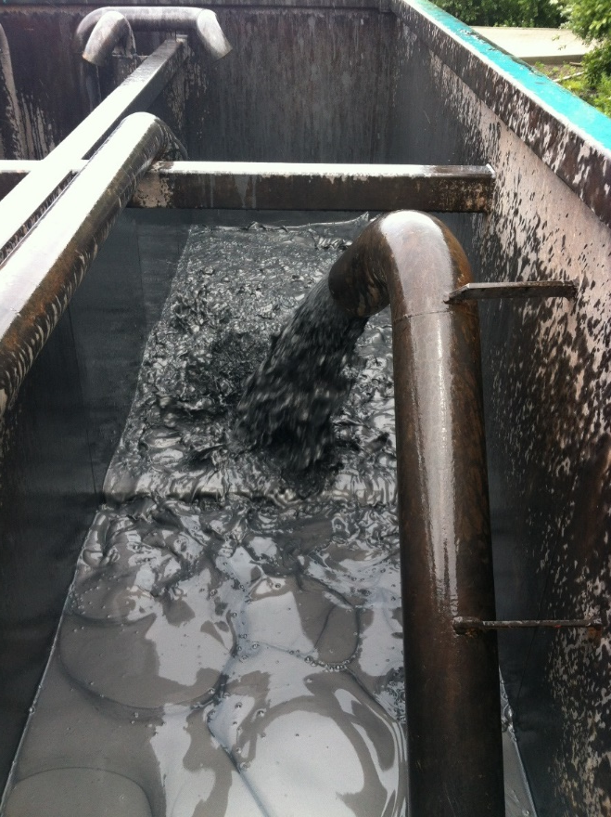
Grouting

Slide 20


Slide 21
CEBO DRILL-GROUT
Properties;
  Self hardening suspension
  Easy to mix and easily pumpable
  Permeability of 1 x 10⁻⁹
  Completely settled after +/- 28 days
  To completely fill the annular spaces
Recommended treatment
  160 – 180 kg/m³

Slide 22
CEBO DRILL-GROUT PLUS
Properties;
  Self hardening suspension
  Easy to mix and easily pumpable
  Permeability of 1 x 10⁻⁹
  Completely settled after <7 days
  To completely fill the annular spaces
Recommended treatment
  330 – 350 kg/m³

Slide 23
CEBO CONDUCT-GEL 1.0
Properties;
  Pre-blended system, which provides uniform slurry
  Easy to mix, low pumping pressures
  Promotes efficient heat transfer (1,05 W/m*K or 0,95 m*K/W)
  No cement
  Can be removed by jet washing
  Low permeability
Recommended treatment
  175 kg/m³

Slide 24
CEBO CONDUCT-GEL 1.3
Properties;
  Pre-blended system, which provides uniform slurry
  Easy to mix, low pumping pressures
  Promotes efficient heat transfer (1,25 W/m*K or 0,80 m*K/W)
  No cement
  Can be removed by jet washing
  Low permeability
Recommended treatment
  844 kg + 675 liter water = 1,1 m³ mixture

Slide 25
CEBO CONDUCT-GEL 1.5
Properties;
  Pre-blended system, which provides uniform slurry
  Easy to mix, low pumping pressures
  Promotes efficient heat transfer (1,43 W/m*K or 0,70 m*K/W)
  No cement
  Can be removed by jet washing
  Low permeability
Recommended treatment
  844 kg + 675 liter water = 1,1 m³ mixture

Slide 26
CEBO CONDUCT-GEL 2.0
Properties;
  Pre-blended system, which provides uniform slurry
  Easy to mix, low pumping pressures
  Promotes efficient heat transfer (2,0 W/m*K or 0,50 m*K/W)
  No cement
  Can be removed by jet washing
  Low permeability
Recommended treatment
  844 kg + 675 liter water = 1,1 m³ mixture

